Slide 1

Grizzly Food Hunt App
Faisal Alhartani, Yunfan Yang,Zeng Zheng, Munjaap Uppal, Bhavdeep Singh

Slide 2
Burndown Chart

Slide 3
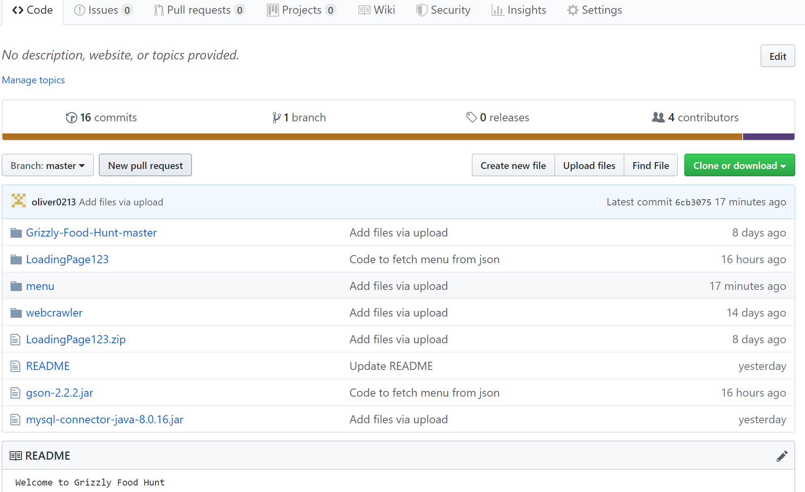
GUI

Slide 4
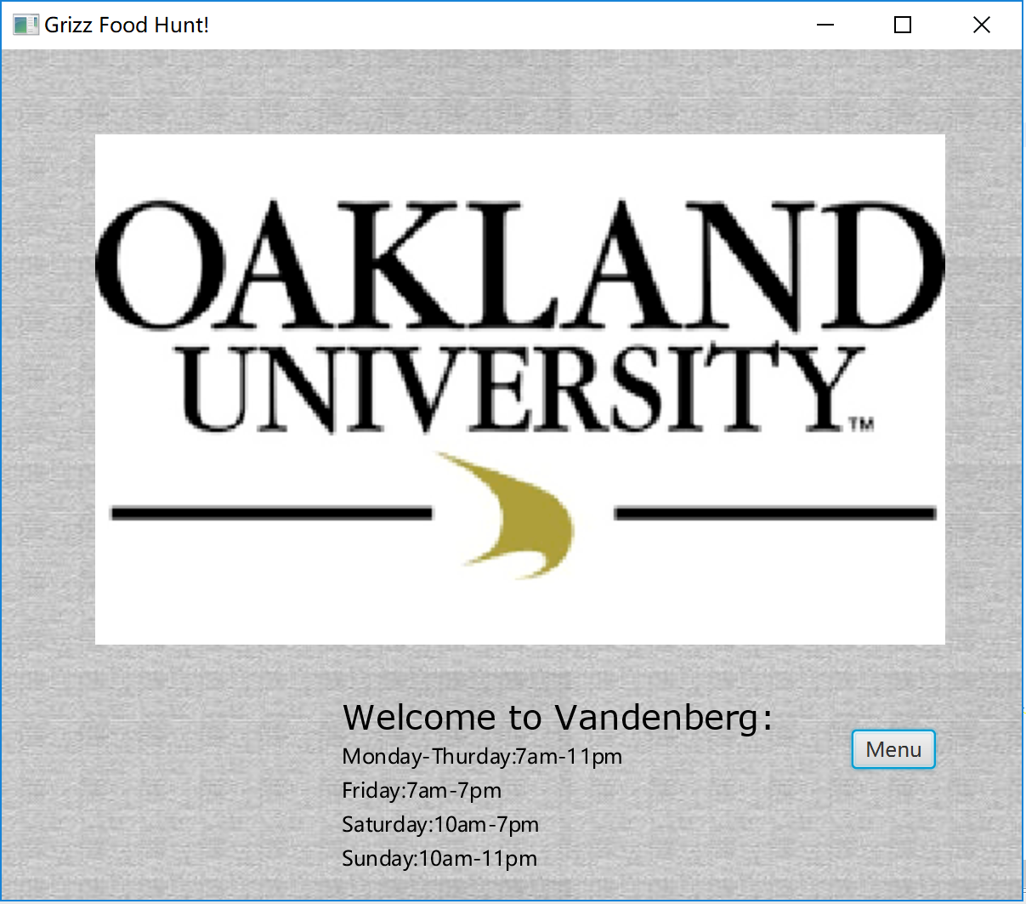
GUI

Slide 5
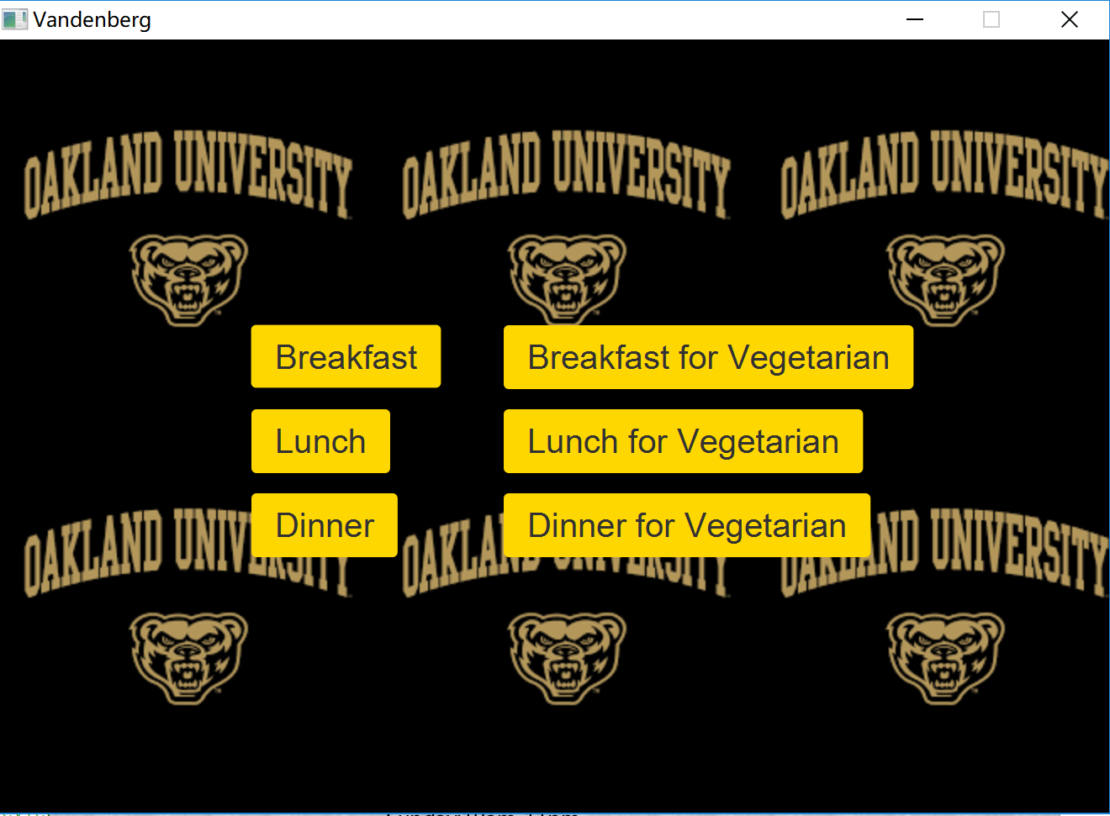
GUI

Slide 6
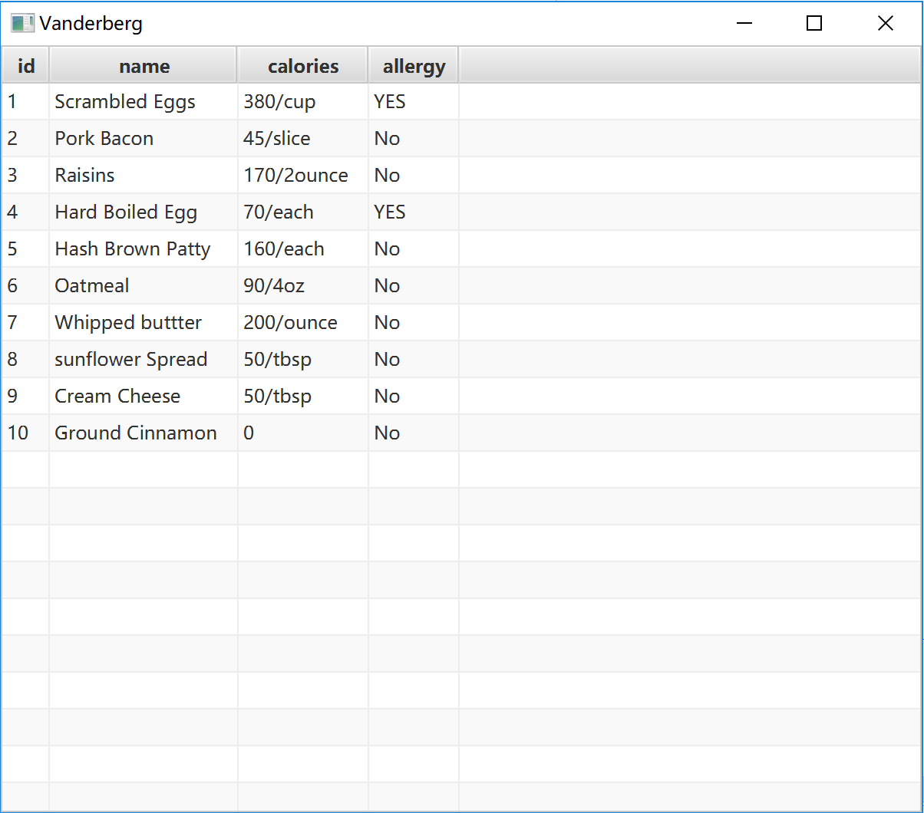

GUI

Slide 7
Future Improvements
Catch Information from the Online Menu
Username and Password Capability
Develop Design
Add Variables to Menu
Add more locations
Add Comments
Add rating(1-5 stars)
Save preferences

